Slide 1


Creating Complex Workflows with System Center 2012 SP1 Orchestrator Andreas Rynes Datacenter Architect Microsoft Corporation
Microsoft Virtual Academy
Notes:
Welcome to another session of the Microsoft Virtual Academy. This time we are talking about Creating Complex Workflows with System Center 2012 SP1 Orchestrator. My name is Andreas Rynes. I am a Datacenter Architect at Microsoft.

Slide 2
Objectives
In this module, you will learn about foundation objects commonly used in complex workflows in SCO
Understand how to create complex workflows incorporating these foundation objects
Notes:
These are the objectives for today:
I would like to give you a quick overview about some foundation objects that are commonly used in complex workflows when you deal with Orchestrator. I would like to give you some sort of understanding on how to create those complex workflows and how to work with those foundation objects and how to make it real in your runbooks.
Objectives
Start Time 00:01 / Length: 1 minute
Microsoft Lync tools used on this page:
None
Review the learning objectives.

Slide 3
Agenda
Query WMI Activity
Invoke Web Service Activity
Query XML Activity
Query Database Activity
Run Program Activity
Run .NET Scripting Activity
Run SSH Command Activity
Notes:
The agenda for today looks like this:
First of all, I would like to talk about how to query WMI. This is 1 activity within the foundation objects of Orchestrator.
Then I would like to talk about how to call or invoke web services within your runbooks.
Then, the third one is how to work with XML files and XML results. This works pretty much together with the web service activity, but we will see that in a second.
Then, I would like to talk a little bit about how to work with databases and how to query databases within your runbooks.
Then, there are 2 activities that are quite interesting. First of all is how to run programs and commands and then how to run .NET scripts. There are a couple of different options here and this is 1 of the powerful activities within Orchestrator.
Last, but not least I would like to show you how to call or how to setup an SSH connection and how to work with that in Orchestrator.
IPv6 Subnet and Address Planning
Start Time 00:04 / Length: 3 minutes
Microsoft Lync tools used on this page:
None
Take the students through the subnet and address plan. Explain the various stages of how the plan comes together.

Slide 4

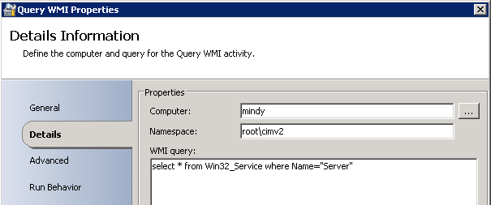
Query WMI Activity
The Query WMI object will send a WMI query to a system that you specify and return the results.
Allows you to choose computer, namespace and custom query
Query output is published to the data bus
Less flexible publishing options than .NET Script Object
Notes:
Starting with Query WMI.
This activity will actually just send a WMI query to a system that you are able to specify. If you see the screen shot on the bottom, that is pretty much what you have to define. First of all, which is the computer you would like to talk to and then the namespace and then you are just entering the WMI query. This really gives you the output on the data bus so whatever that WMI query will return, this data will be published to the data bus. There are a couple of items that will be published so the computer where the WMI query is performed, the WMI query itself will be published on the data bus and, of course, the query result of the WMI query will be published as a string to the data bus as well. Plus, the namespace will be there as well. After using that activity within your runbook you can grab the results and the namespace and the computer and the query from the data bus and work with that from there. That is pretty much it about the WMI activity, but pretty powerful, but of course, less flexible than the .NET script objects that we are going to tackle in a few slides.

Slide 5
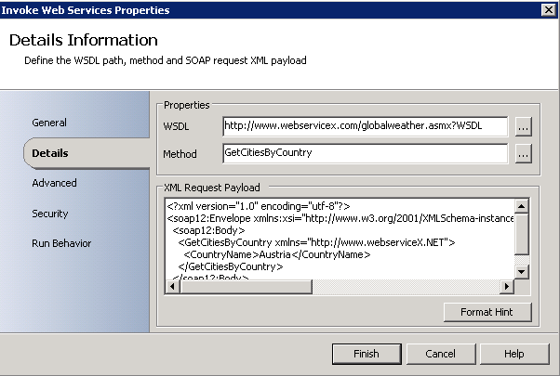

Invoke Web Services Activity
Executes a web service with XML parameters that you specify
Required info to access web service
WSDL file of the web service
Web service method name
Input and Output SOAP message body format
Support SOAP 1.1 and 1.2
An XML document is returned as response payload
Once the XML document has been returned, you can search the result with XPath queries
TIP: Use the ‘Format Hint’ button to auto-populate the XML Request Payload field
Notes:
The next one which is also quite interesting is how to work with web services. There is 1 activity that is called invoke web service and that invoke web service really runs a web service and gives you the options to define XML parameters and give you also, of course, the result as the XML. In the screen shot on the right you see that you have to define the WSDL file which is actually the description file of the web service. Whenever you go out to the web and check for some available web services there is always a web service available for free just to work and test with that so you can use that one and then you just have to define the WSDL URL in the first text box. The next one is the method so the web service you go into use might have a different or multiple methods. In this case, we have 1 method called Get Cities by Country which just gives you a list of cities by a specified country and then you have to define the SML request payload and there is this button, Format Hint, on the very bottom of that window which gives you hints on how to format the XML payload. That is actually the input for the web service method that you specified above.
With that activity we will support SOAP 1.1 and 1.2 and the result will be published on the data bus again and this is an XML document that you can then parse with XPath queries using the next activity that is called query XML.
That is more-or-less it. Of course, you can also define how to use authentication, HTTP authentication in the advanced tab of that window on the right. So, you can define a username and define passwords and another option is to use HTTPS certificates, but that is not part of that window, but in the designer there is the option menu where you are able to define HTTPS certificates in there.

Slide 6
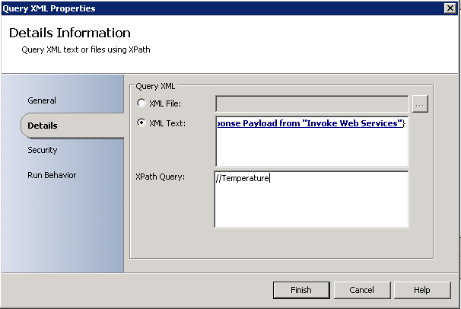

Query XML Activity
Used to perform XPath queries on an XML file
Used to query the XML response payload returned with the Invoke Web Services object
Can also be used to parse XML files on the file system
Supports common XPath query options
Notes:
The next one is actually query XML activity. That is the one that you probably will use if you are going to work with web services because in 1 way or the other you would like to work with the results of that web service, but of course, you can also use an XML file that you have grabbed from the file system somewhere else. Actually you have in the window at the right you see you either define the XML file or you just define the block of XML which might be the published data from the invoke web service that happens before that activity. The most important part is the XPath query. If you are not familiar with XPath, that is a pretty powerful language which to parse XML files and to grab data out there so either elements, attributes and you can define filters there and actually it is a pretty powerful language XPath so you find a couple of information on how to work with that online, but there you define the XPath query and the results from that will be published on the data bus again. If you run that activity if you go to the data bus you will have the query result published there, XML attributes published there, you will have the XPath query itself published in the data bus and also the note count so if you are looking, for example for an element called temperature and there are a couple of elements there that are called temperature you will also get the count of the notes or the elements in the data bus as well as a published variable there as well.

Slide 7


Query Database Activity
Query a database and return the resulting rows as Published Data
Supports the following database options
Microsoft Access
ODBC
SQL Server
Oracle
Fields are returned in semi-colon delimited format
Use Field data manipulation function to obtain specific values
Notes:
The next one is Query Database Activity. It really does what it says. You are able to query a database table and we are going to support the following databases:
Microsoft Access. You can define ODBC and you can use SQL server, of course, and Oracle databases.
With that, you define your connection string. You are able to define your authentication method. For a SQL server, for example, you are able to define if you are going to use windows authentication or SQL server authentication. Then you define your query the way you would do it in a standard SQL tool to query database tables. The resulting rows will be published to the data bus again. The fields are returned in semi-colon format and then, of course, you can use those manipulation functions that I showed you in another session before that on how to work with strings.

Slide 8

Run Program Activity
Runs any program or command on any computer in your domain in interactive or background mode
Requires you know a few things about the application or command
Required Parameters
Required Permissions
Interactive or Background Mode
Published output includes program output, process ID, exit code
Note: “Interactive” mode does not work the same on 2008 due to UAC restrictions.
Notes:
Another one is the Run Program Activity. The Run Program Activity gives you the option to run any program or any command on a specified computer in you domain. You can either do that in an interactive mode or in a background mode. For example, you can run a batch script with that or even a set of complex demands, for example. The way you are going to configure that activity is pretty simple. You either define if it is a command line that you would like to run or if it is a program that would like to run and, of course, you will need to define the target computer and you also have to define which user account will run that program or the command. That is the important part, that user account needs to have admin rights and permissions on that target computer to run that program so that is the important part. Of course, you also have to think about, should it be an interactive mode? Should there be an interaction with the user in front of that computer or should it run in the background mode without any interaction with a user.
If you are going to use the program execution mode you just are able to grab that executable from your file system or you are using the command execution then you are just using it the same way as you are using a windows command prompt. Then, you define the computer and then there is also a program path you have to define where the commands or the program is located. You are defining your parameters, of course, that you would like to pass in and you can, of course, use a published data and published variables there as well.
One more thing you have to define which is actually on a separate tab called Advanced which is actually the execution mode so again there are actually 3 different options for the execution mode. First of all, it is interactive so if you want to display the user interface to give a user on that target computer you have to choose interactive. The other way is to run that program or command in the background and there are 2 options there; normal and low priority, but in both ways you won’t have a user interface that really runs in the background and the process priority is set to what you specified so either low or normal.
What I want to mention here is that also you are able to wait for completion of that activity and that program so you can define if that activity should wait if that program or command is finished. For the interactive mode, that happens only if the user closes the program and for the background mode it really waits if that program or command is completed. Of course, you can also set a timeout here so a terminate after X minutes and then it will wait and terminate that program if it is not finished by that time. Of course, you can specify a user name and a password for both authentication and that is important to know for active mode. It will open that session or that interactive command prompt in that user session that you specified in the user name so that is important to know.
Of course, published data is used here as well so after that activity runs there is a couple of data that will be published to the data bus. Of course, it is the parameters, the path, the process ID, the output of that program, the exit code which are the 2 most important ones, then an unmodified output of the program will be published to the data bus as well and a couple of other variables will be published as well.

Slide 9

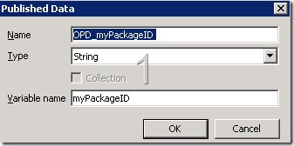
Run .NET Scripting Activity
Runs scripts written in VB.Net, JScript, C# and Windows PowerShell
Each variable can be subscribed to individually
Both single values and collections (arrays) supported
Normal execution behavior applies in downstream objects (remember ‘flatten’ can help)
.NET languages require namespace references
Value in Variable name field should match the variable name in your script
Notes:
Probably the most powerful activity within the foundation objects is the Run .NET Scripting Activity.
With that, you are able to run scripts and those scripts can be written actually in VB.Net, JScript, in C# or even Windows PowerShell. Those are the options that you have with that activity. We are actually supporting the .NET CLR version 2.0 and later so that is a pretty powerful activity where you can really work with scripts with parsing data with .NET API’s and a lot of things can be done here. For example, if you want to work with PowerShell commandlets, I mean if you think about all the Microsoft products, they have support for a lot of commandlets. System Center, for example, has tons of commandlets where you can really do almost everything with PowerShell and you are now able to work with that within Orchestrator within your workflow.
What you have to think about when you start using the Run .Net Scripting Activities, first of all, the code that you want to run and then, of course, which libraries or namespaces you would like to use in that script and the data you want to publish. From a security perspective it is important to understand that the user account that is defined as the runbooks service account will be used for that for the security credentials for that script so whenever that script runs against another computer, the runbooks service account will be used for authentication and it has to have access to the resources and for the stuff you are going to do with your script.
From a configuration perspective, it is pretty much easy; it is just 2 things that you have to define on the first tab, it is the type so it is VB.Net, Jscript, C# or Windows PowerShell and then it is just a big box for your script and then there is another tab where you have to define namespaces so in case you would like to use some .NET namespaceI and you don’t want to have a fully qualified name with every object and every method you are going to call from that namespace, you have to define those namespaces there and you can also define the references there as well to assemblies that you are going to use in your script.
Then, you are almost done. You just have to define the published data and those are either date/time, string types or collections so if your data is multi-value data than you define collections as your published data and you give those published data a name and then, of course, you also have to give them a variable name which then automatically created a .NET property for those items and then you are going to assign the values to those .NET properties and then this will be published to the data bus at the end.
Actually, that is it about the .NET scripting and, again, it is a very powerful way to work with different systems, different tools so you can really run all your PowerShell commandlets you can think of. You can work with .NET API’s. You can use your JScript stuff. Everything that would work with your runbooks now with that Run .NET scripting activity.

Slide 10
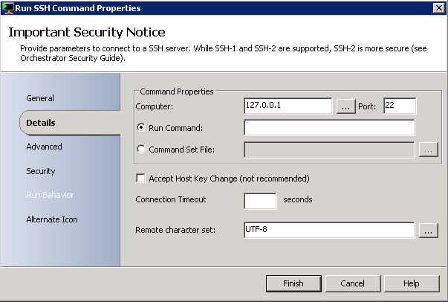

Run SSH Command Activity
Opens SSH connection to remote server and runs shell commands
Support for key files, username, password, passphrase
Commands and Command Set File
Notes:
Last, but not least it is the Run SSH Command Activity. Actually, it really again does what it says.
It opens an SSH connection to a remote server that you specify on the computer in a text box and then it really runs shell commands here and with supporting not only commands, but command set files. You can specify also the support that is going to be used, a connection timeout with seconds and also the character set can be defined here as well. Of course, we are also supporting user names and passwords and pass phrases for authentication here as well, plus key files so this is another activity that is part of the foundation of Orchestrator 2012 which you can use to create your complex workflows.

Slide 11
Demo
Notes:
Now I would like to give you some short Demo’s with a couple of different runbooks explaining to you how to work with those activities in a real environment with real runbooks.
First of all, I would like to show you how to use the query WMI activity so I have created a simple runbook that has 3 activities. First of all, the starting point is, again, the Monitor Date/Time activity that is defined to run every 5 seconds. The next one is the query WMI activity itself and I have defined my remote server which is called WMI 1. I have defined the namespace that I am going to use for the WMI query and then the query itself called select caption from win 32 operating system. I am done with that query so it asks me if I would like to check out the runbook. I am not going to change anything here. It is done already and then I am going to use the send platform event which is part of the notification foundation object part and I am going to write an information type notification to the platform. I add a summary, WMI output and then I am using a published data so I am going to remove that here and show you how I have done that one so I am going to right click. Subscribe, published data, and then I have the WMI query result as string and I am using that one pretty straightforward so I am done here. I am able to check in that runbook and I am starting that. It will immediately create 1 instance so in the real time log you see immediately 1 instance. It is there. It was created by the runbook server and you see the output already so it runs through all the 3 activities and the platform events you will find here at the event section and it is already running a couple of times and you see the summary, WMI output, the caption; it is Microsoft Windows Server Center 2012 Data Center and you see the type of information, everything that we have defined in that center platform event activity. That is a pretty simple example on how to use query WMI activity.
Another example in runbook where I would like to show you a couple of different complex activities that we have discussed now is the one that I call Web Service here. So again, the Monitor Date/Time activity. It will run every 20 seconds. Okay, I will go and check out that runbook first, then I use the query database activity where I have defined the connection to a database. This time I am using the SQL server using windows authentication. I have defined my server name, this is SQL 1. My initial catalog that is the database name, that is Test DD. I have defined also my security account for that and then in the details pain, the details tab, I have defined my query select, top 1 * from countrycity. That table is actually pretty easy; it just has got 2 columns, 1 is country column and 1 is a city column so I have a couple of entries with cities in specific countries. From there is goes directly to the invoke web service activity, double click here. I am going to use a global available web service with that URL so I have defined the WSDL URL of that web service. You can just grab that URL, paste it to your browser and you will see the description file of that web service and if you double click on that button here you will get all the methods that are available, actually there are only 2 here, and I am using the Get Weather method of that web service and then if you click on the Format Hint button down here it will add this XML request payload and the only thing you have to do is add your parameters you have to pass into that method. So, Get Weather defines 2 input parameters, city name and country name and I am going to use those from the database. If I click on Format Hint I will get city name, string, city name, country name, string, country name and I just have to replace those strings will real values so I can, of course, define a hard-coded city name and country name here, but I would like to use those from the database so I am replacing those so for the city name I am going to use, right click, some published data here so I am going to create database activity so we are going to use the full line as a string and that is actually the published data for every record so if the query database returns 3 records I will get 3 full lines with the records with all the columns separated by semi-colons so I am going to use that here, but I only need the city name here so I have to use some string manipulation function that is called Field. The first parameter of that is the full line that I am getting back from the database. Then I have to define what is the separator for each of the columns here and which field I want to use here so I would like to use field #2 because field #1 is an ID. #2 is the city name and #3 is the country name so again I am using published data here the same way as before using the full line here and this time I am also using the field function here and I forgot this bracket here that is #3 of that row. So, that is it with that. I used published data from the query database activity and pushed that as a parameter to the web service. So, I am now done with that. Click on finish.
This invoke web service call will give me some reply XML response back and I am going to use the query XML activity here using the XML response from the invoke web service and then I am defining my XPath query here and I am just grabbing the element, Get Better Result wherever it is in that XML and then I am adding that to a file. I am using the append line. I am defining an XML message and the filing coding is set to auto and then as a text I am using the query result also published data so I am able to show you that here without clicking on OK. I am using the query result from the query XML response activity and this will just add that part of the XML response from the web service and write that to that file here, defined here in the file text box.
With that, I am able to test that. I am going ahead to check in runbook so I am done with the check in and I am going ahead and click on run and if we go to the log we will immediately see 1 instance coming up so now it will run through all the activities. First it will query the database. In this case we have to define the query top 1 so it will really only return 1 row with a city and a country and with that city and country it will go to the web service and call that web service and it will get back some XML response and I am going to create a file there. We see that was done already. Everything was a success and if we now go to the folder that I have defined, C: web service message, you will see a weather.XML file which was recently created. If we are going to open that with notepad see the XML response that was part of that web service, what was published by the web service with the information we passed in from the database. One quick change here so that you are able to see that so, create database. I am just removing the top 1 from the query so we will get all the data that is in the database. I need to check out that so I have found the changes, just double check that so it is select 1 * from countrycity table. Checking again and first I am going to remove the weather XML file so we are going to run that guy again back to the log file, see the new instance coming up and waiting a couple of seconds. Now it takes a little bit longer because it has to call the invoke web service a couple of times. So, create database does not return 1 row, but it will return a couple of rows. I am not quite sure about the count, but I guess it will be about 5 to 6 rows in there and, let’s see, that one is not the one from now it was the one from when I pressed the start button. So, here is the new one. You see that the query database was run once, but then it calls the invoke web service activities a couple of times for each row of the query database. It called the invoke web service here and again query XML response. It will query the XML for every call to the web service and also add that to the file a couple of times so if we, let’s stop that first, I need to close that here and stop that here and then if we go to the message, open the weather XML file again and using notepad you will see the different locations so this one is Alice Springs in Australia and here is Rockhampton Airport in Australia, Adelaide Airport and all those cities that are defined in the database.
With that, I showed you a couple of different complex activities and I hope that you understand the different ideas behind those different activities and how to use them.

Slide 12
Summary
Discussion of options for various data sources
Understanding how to parse web service response payload
Review of supported database options
Review of script execution options
Understanding how to parse published output
Publishing script variables
Handling collections (arrays) in output
Notes:
As a summary, I have talked a little bit about the different foundation objects that are most likely from interest. If you think about more complex scenarios that you would like to tackle with Orchestrator, how those are supported, which options you have with them. What are the scripting options you have with Orchestrator and the scripting activity and how published data will be used in each of those activities which is one of the most important parts so how every activity will publish data to the data bus and how you grab that data from the data bus and, again, work with that throughout your scenario and your workflows.

Slide 13
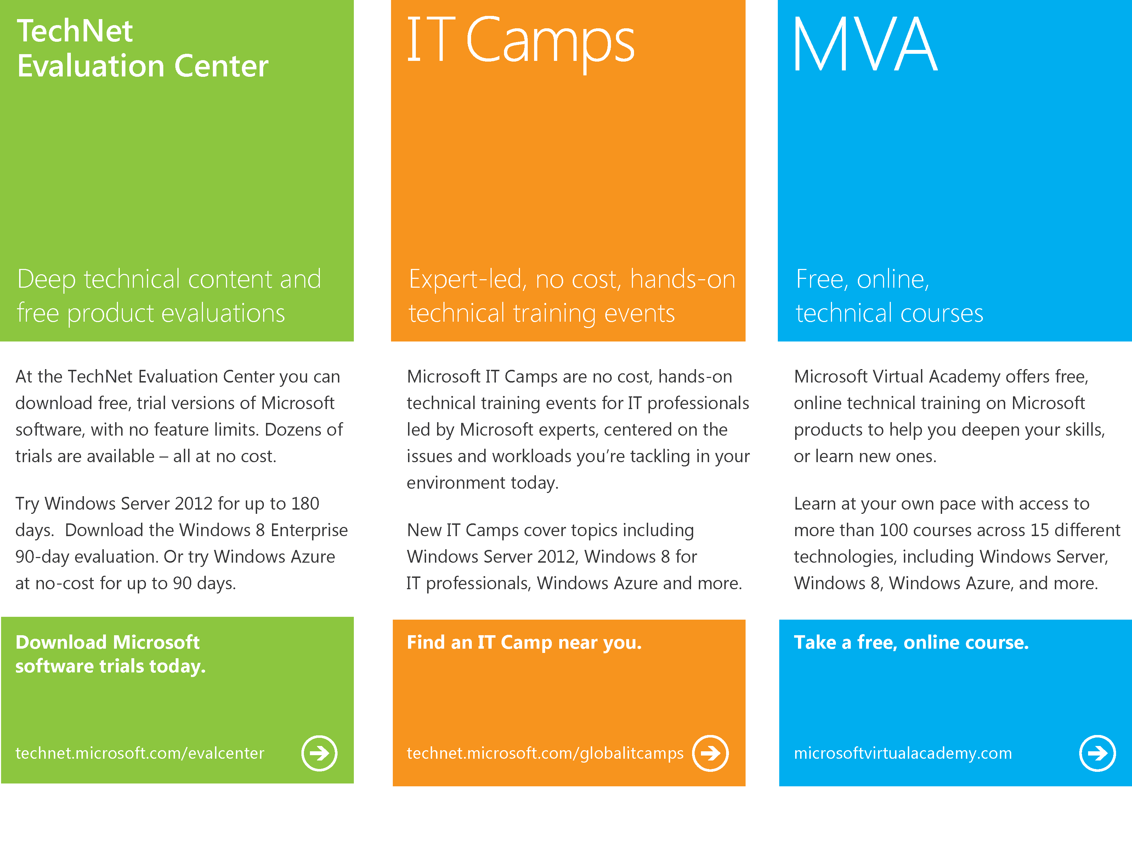
Notes:
At the end, again, I would like to give you some more links on where you can find more information about Microsoft software and how to do another technical training and find more information on that. First of all, it is the TechNet Eval Center which you find on technet.microsoft.com/evalcenter where you can find trial versions that you can download for free from Microsoft software. Then we have the IT Camps which is on technet.Microsoft.com/globalitcamps where you will find a lot of technical training events for IT professionals and last, but not least, the Microsoft Virtual Academy which offers really technical training for Microsoft products as well which is on microsoftvirtualacademy.com.

Slide 14

© 2012 Microsoft Corporation. All rights reserved. Microsoft, Windows, Windows Vista and other product names are or may be registered trademarks and/or trademarks in the U.S. and/or other countries.
The information herein is for informational purposes only and represents the current view of Microsoft Corporation as of the date of this presentation. Because Microsoft must respond to changing market conditions, it should not be interpreted to be a commitment on the part of Microsoft, and Microsoft cannot guarantee the accuracy of any information provided after the date of this presentation. MICROSOFT MAKES NO WARRANTIES, EXPRESS, IMPLIED OR STATUTORY, AS TO THE INFORMATION IN THIS PRESENTATION.
Notes:
With that, thank you very much for your time and see you soon on another session on Orchestrator 2012 on Microsoft Virtual Academy. Thank you.

